Slide 1
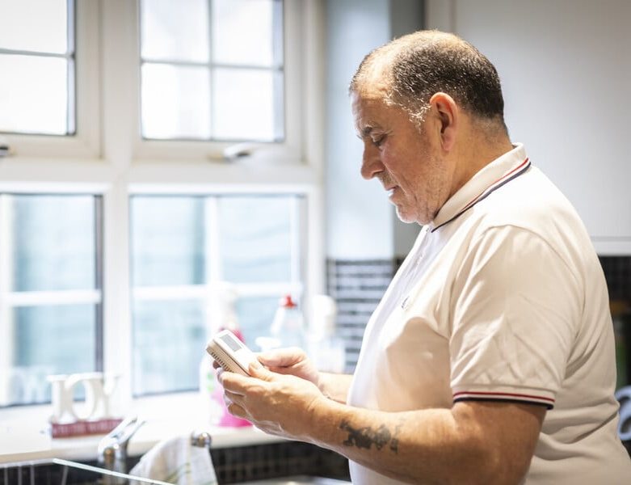
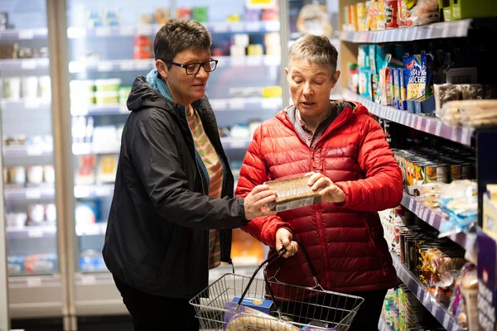
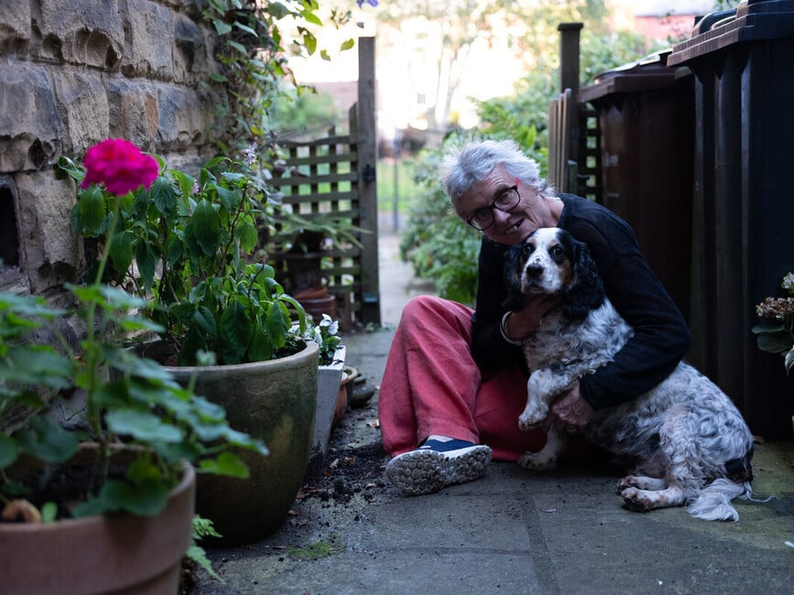
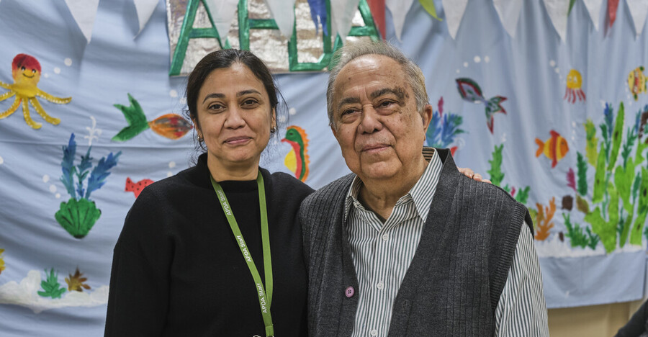
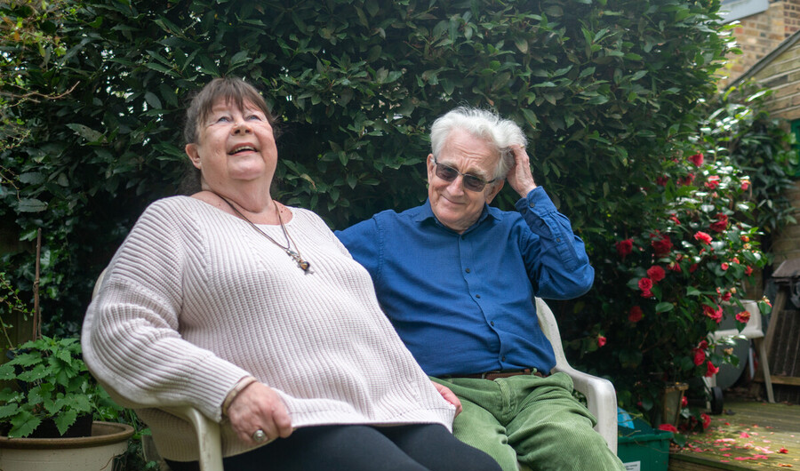

Wales Webinar 4th September 2025 Key reflections and messages from 10 years of AWOC campaigning Jenny Collieson, Co-Chair AWOC
Graphics courtesy of Centre for Ageing Better Age-Positive Image Library
Notes:
Firstly, on behalf of AWOC I’d like to thank you for inviting me to participate in this webinar – and for the publication of the Older People Without Children report which we welcome and appreciate and the findings and recommendations of which we endorse.
One of our objectives from the start has also been to stimulate and promote further research into ageing without children and from my personal perspective as a former writer of lit reviews it’s great to see a new literature review on the topic

Slide 2
AWOC timeline – key developments
2014 Guardian article by Kirsty Woodard “Ageing without children: why is no one talking about it?”
2015
London Conference “But who will look after you when you’re Old?”
CIC formed with small Board
First local groups outside London set up
2016
Our Voices report published
2nd AWOC Conference (Birmingham) “Planning for later life”
2019 PRAMA Foundation took on AWOC assets/website
2020-2021
Pandemic reports published
AWOC became a new charity
NCF published AWOC Toolkit
2022 – 2025
Board expanded; articles/interviews across the media;
Webinars addressing specific AWOC challenges
More local groups set up; new website launched
Notes:
AWOC timeline – key developments over the past decade since the initial Guardian article and the first AWOC Conference in London
Our starting point was that as the article stated nobody was talking about ageing without children in relation to policy on ageing – this included the organisations working with and on behalf of older people – a shared concern about what happens to an ageing population without children when health and care provision is under such pressure
Initial AWOC focus on campaigning, raising awareness, providing a space where people who were AWOC to meet and talk about how this impacted on them, encouraging research into assumptions made about ageing without children and looking at ways to create more sustaninable long term solutions to different forms of support
Wrongly seen as a women’s issue “Falling fertility what will the UK be like with fewer babies” Guardian (30 August) – Jane Falkingham Director of Centre for Population Change -
Interestingly a decade later in 2024 The Guardian published another article by one of its own journalists “the shrunken state expects families to fill the voids in health and social care. Woe betide those without children”
Ageing policies do not differentiate between those with family support – and those without – initially seen by some as a non-issue
Our work pre-pandemic – working with Beth Johnson Foundation – Our Voces a key report – be good to do something similar now to see how they compare . All reports can be downloaded from our website
Our Voices report 400 people were asked about thei
Quick run through recent developments – Covid, the two reports on impact of the pandemic – decision to reform as a charity

Slide 3
Key reflections 1
Over a decade of raising awareness & getting the impact acknowledged at national level- it was a hard sell initially although also resonated with many!
Being AWOC can exacerbate some of the more recognised challenges ageing people may face (also exposing of other inequalities and intersectionality) – a social and equalities issue
Common concerns continue to be – fear of judgement, invisibility (who will speak up for me), social isolation, unmet care needs, loss of independence, dementia, EOL care, dying alone
Being able to access AWOC-relevant information and advice – both formally and informally (e.g. Facebook sharing) is essential
The experience of being a carer, often for for ageing parents can be a key trigger - the majority of AWOCs are or have been carers
“It’s more than you think” Not a homogenous group, growing numbers and increasingly diverse experience of growing older without children (for many different reasons)
Notes:
The external “environment” has changed over the past decade – there is greater recognition and awareness (largely due to the campaigning work of AWOC over the past decade) now of the impact of ageing without children/family support and of the future implications of this demographic and social and cultural shift (cf Guardian article last weekend) and of the needs of a growing number of people who are growing older without the availability of family care and support – however the policy, legislation and solutions require more focus and investment we need a wider range of alternative models of support and approaches and – more research on the effectiveness of different interventions and effectiveness of particular approaches. Time for more solutions
Also growing numbers of younger people debating on whether to have children or not – economic challenges, anxieties around climate change, and the uncertainty of world politics, more personal choice
What I also appreciate about the report is that it mentions that there can also be strengths and lessons to be learned from the way people ageing without children individually and collectively demonstrate great adaptability and resilience in trying to shape care and support and advocate for services that bets meet our specific needs – there are positive messages and opportunities and we try to focus on those as well as highlighting the challenges
Fears – also particularly around invisibility and having nobody to speak up for you in care settings. Dying alone – last week’s article in Guardian “epidemic of lonely deaths with 68,000 people expected to die alone and unnoticed this year in UK mainly aged over 65
Targetted advice, interventions and support needed which recognise and understand the challenge that AWOCs can face
AWOC part of a wider movement of campaigns and groups challenging the status quo in health and social care – WIGO, Social care Future etc
Experience of being a carer – that is the family carer angle – recent presentation to Carers Research Advisory Group conference – comes up a lot as that lightbulb moment for many who join us
AWOC is about to embark on a strategy review to look at what is now needed in terms of future support – where we focus our efforts and how we can work with other organisations at both local and national level to develop practical solutions and embed AWOC considerations into national policy frameworks

Slide 4
Key reflections 2
Partnership with other older people’s organisations, national and local government, academic institutions, & voluntary & community sector groups to integrate AWOC considerations into policy, research and services & change attitudes
Individual stories and the diverse experiences of ageing without children to highlight impact on services and communities, share success stories and work together to co-produce solutions
Need for improved data - too narrowly focused on women’s fertility
Involve younger people without children & employers – a life course approach & importance of proactive planning for later life
AWOC is part of a wider movement for challenging expectations about later life and care and reflects the demand for more choice and autonomy
Volunteers are at the heart of what AWOC does – importance of peer-led practical and emotional support embedded at grassroots level
Notes:
AWOC is about to embark on a strategy review to look at what is now needed in terms of future support – where we focus our efforts and how we can work with other organisations at both local and national level to develop practical sustainable solutions and embed AWOC considerations into national and local policy frameworks
In past we have worked with local Age Uks PRAMA Care, Independent Age, National Care Forum – see reports on our website
Individual stories to reflect the voices and diversity of the AWOC experience – and to highlight the positive contributions people ageing without children make . Importance of intergenerational approaches ss more young people publicly debate issues around childless/childfree lives
Evaluation of different interventions and effectiveness of different models – next stage
Importance of co-design/co-production in developing targetted support – public participation groups, lived experience – for example at the moment I’m involved with an NIHR social frailty project in York which is looking at the various factors which contribute to social frailty and how these may be identified (lack of family and AWOC issues now being included)
As this report highlights the lack of data – and narrow focus on data around women’s fertility as the only measure hinders the development of positive targeted interventions

Slide 5

Messages
Improve data collection on people ageing without children where they are and how they live
Don’t make assumptions!
Partnership and investment in development of more choice and of innovative solutions in care and housing to address needs of people ageing without family support
More research is needed on many aspects of AWOC experience – both positive and negative – and on the development and evaluation of successful AWOC interventions & models of support
Strengthen legal protections and improve advocacy support. Many AWOCs are also self-funders – there is a growing target market for new business solutions too
There are many positive lessons to be learned about ageing from the experiences of people ageing without children – resilience, the importance of alternative networks, proactive steps in planning for later life,
Addressing specific AWOC concerns and improving support benefits all older people and the communities they live in
Notes:
Our messages from our first decade of campaigning – many if not most of these are echoed and reflected in the findings of this report
Count Us – discussions with politicians and the ONS about more effective ways of identifying people ageing without children at local and national level
Research – we definitely support the need for more research into the AWOC experience, its diversity and the range of potential interventions which can provide better support
Work we are doing at the moment on advocacy and webinars end of life, LPAs wills, etc –

Slide 6
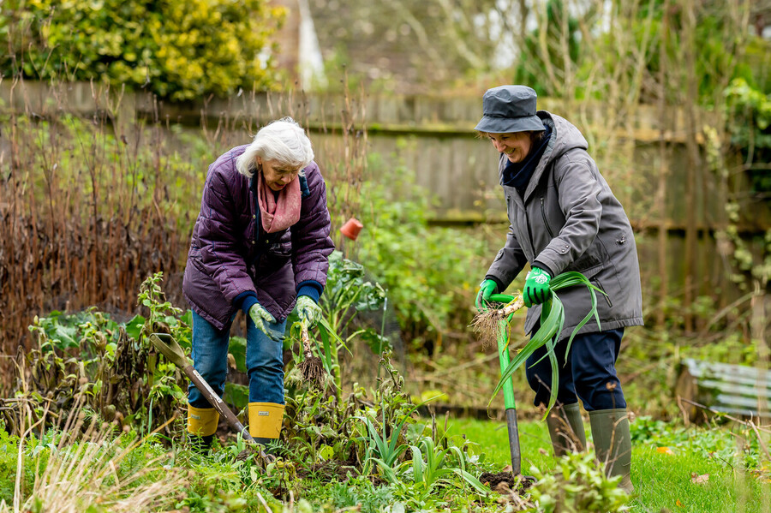
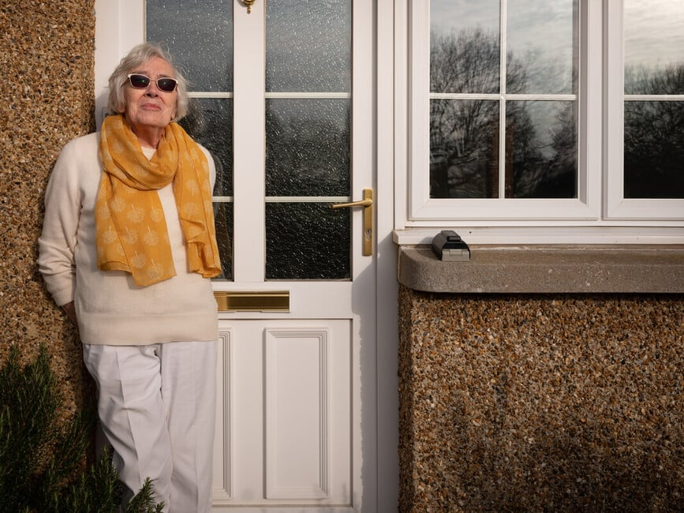

Email: info@awoc.org.uk
Facebook
Notes:
Lastly, I we have a national Facebook group and some local AWOC groups also have their own websites/FB groups

